Slide 1
EOS/ESD Association, Inc.
Tech Talk: ESD First Aid Tutorial: Selecting the Right TVS Protection Device
November 12, 2024
Join us for a 45-minute ESD First Aid Tutorial focused on selecting the right TVS (Transient Voltage Suppressor) protection device, followed by a 15-minute Q&A session. This presentation will guide attendees through a systematic approach using the SEED (System Efficient ESD Design) methodology to enhance ESD robustness. We will address common misunderstandings about TVS protection, covering device characterization, protection schemes, layout considerations, and the significance of datasheet parameters. Attendees will learn about current sharing dynamics between TVS devices and ASICs, the role of simulation and emulation, and how to optimize cost, performance, and robustness in selecting protection devices. This comprehensive tutorial aims to equip designers with the knowledge to make informed decisions and effectively safeguard their systems against ESD events.
https://www.esda.org/events

Slide 2
EOS/ESD Association, Inc.
ESD Compliance Verification Technician to TR53
February 28-March 2, 2025
Riverside Convention Center
Riverside, CA
EOS/ESD Association, Inc. established ESD Compliance Verification Technician, which is based on the ESDA’s technical report, ESD-TR53 Compliance Verification of ESD Protective Equipment and Materials.
Become certified by industry leaders, developers, and authors of ESD-TR53.
The ESD Compliance Verification Technician certification provides an understanding of ESD concepts, how compliance verification fits into an ESD control program, and details all the necessary equipment, methods, and best practices to successfully conduct compliance verification within your organization.
Register: https://www.esda.org/events/

Slide 3
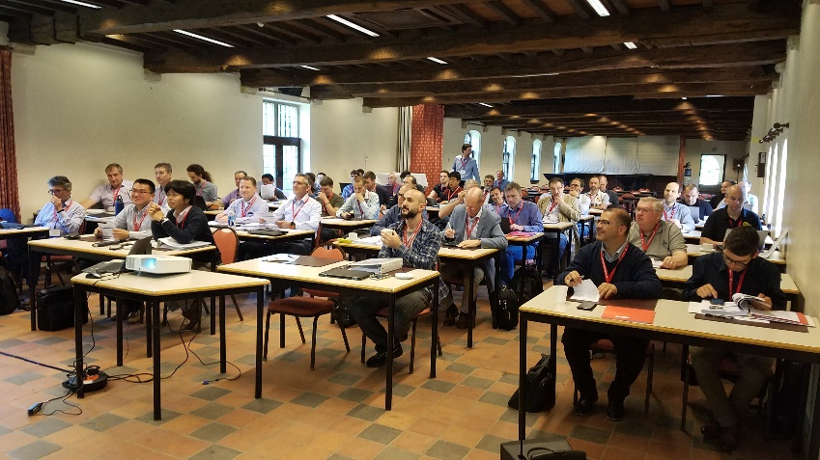
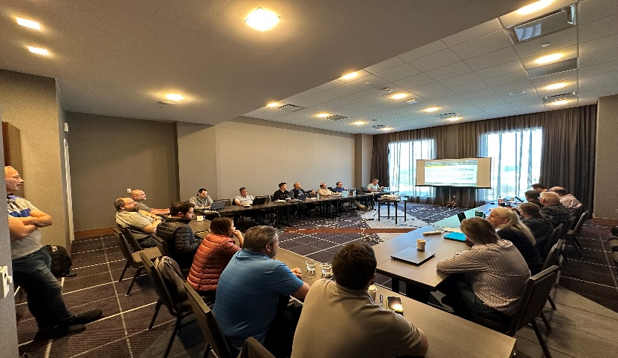
EOS/ESD Association, Inc.
EOS/ESD ASSOCIATION, MEETING SERIES
March 3-9, 2025
Riverside Convention Center
Riverside, CA
Mark your calendars for an invaluable networking opportunity at the 2025 March Standards Meeting Series, happening March 3-9 at the Riverside Convention Center in Riverside, California. Engage with ESD standards working groups, discuss industry hot topics, and explore new research and training opportunities. Enhance your professional growth by connecting with industry peers and staying abreast of the latest in ESD and EOS.
https://www.esda.org/events

Slide 4
EOS/ESD Association, Inc.
2025 US ESD Workshop (US-IEW)
March 30-April 3, 2025
Hyatt Regency Monterey
Monterey, CA
For over 60 years, IRPS has been the premiere conference for engineers and scientists to present new and original work in the area of microelectronics reliability. Drawing participants from the United States, Europe, Asia, and all other parts of the world, IRPS seeks to understand the reliability of semiconductor devices, integrated circuits, and microelectronic systems through an improved understanding of both the physics of failure as well as the application environment. IRPS provides numerous opportunities for attendees to increase their knowledge and understanding of all aspects of microelectronics reliability. It is also an outstanding chance to meet and network with reliability colleagues from around the world. IRPS is Co-Sponsored by IEEE EDS and Reliability Society.
https://www.esda.org/events

Slide 5
EOS/ESD Association, Inc.
2025 International ESD Workshop (IEW) - Europe
May 12-16, 2025
Hotel Dubrovnik in Zagreb
Gajeva ulica 1, Zagreb, Croatia
In its 18th year and in collaboration with the EOS/ESD Symposium, the International ESD Workshop (IEW) offers a relaxed setting for presenting new work and discussing Electrostatic Discharge (ESD) and Electrical Overstress (EOS) issues. Next to tutorials and seminars, this time there will be a greater focus on discussion groups and invited speakers. Technical sessions include five-minute teaser presentations followed by interactive poster discussions.
Focus Topics:
IC design • Chiplet-level ESD • Chip-level ESD • System-level ESD • EDA • Automotive • Failure analysis • Testing • Advanced technologies
https://www.esda.org/events

Slide 6
EOS/ESD Association, Inc.
EOS/ESD ASSOCIATION, MEETING SERIES
June 2-9, 2025
Nugget
Sparks, NV
Mark your calendars for an invaluable networking opportunity at the 2025 June Standards Meeting Series, happening June 2-9 at the Nugget in Sparks, Nevada. Engage with ESD standards working groups, discuss industry hot topics, and explore new research and training opportunities. Enhance your professional growth by connecting with industry peers and staying abreast of the latest in ESD and EOS.
https://www.esda.org/events

Slide 7
EOS/ESD Association, Inc.
EOS/ESD ASSOCIATION, MEETING SERIES
September 8-14, 2025
Riverside Convention Center
Riverside, CA
Mark your calendars for an invaluable networking opportunity at the 2025 September Standards Meeting Series, happening September 8-14 at the Riverside Convention Center in Riverside, California. Engage with ESD standards working groups, discuss industry hot topics, and explore new research and training opportunities. Enhance your professional growth by connecting with industry peers and staying abreast of the latest in ESD and EOS.
https://www.esda.org/events

Slide 8
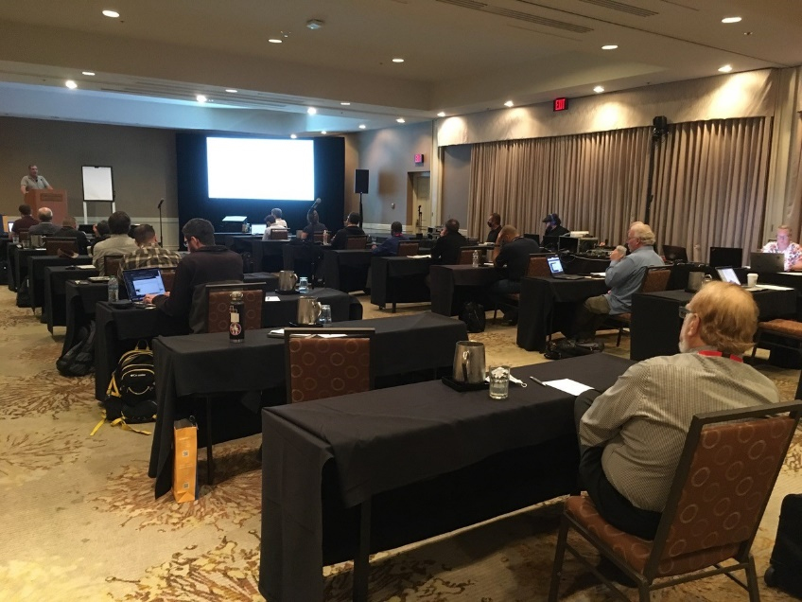
EOS/ESD Association, Inc.
47TH ANNUAL EOS/ESD SYMPOSIUM AND EXHIBITS
September 13-18, 2025
at the Riverside Convention Center, Riverside, CA USA
The EOS/ESD Symposium is dedicated to the understanding of issues related to electrostatic discharge and electrical transients/overstress, and the application of this knowledge to the solution of problems in consumer, industrial, and automotive applications, including electronic components, as well as in systems, subsystems, and equipment.
https://www.esda.events

Slide 9
EOS/ESD Association, Inc.
ESDA Online Academy
Over 40 Online Courses Available for
On-Demand Viewing.
Certification Courses
Bundle Purchase Options Available
For a complete list of courses and registration information please visit:
https://www.esda.org/store/training-and-education/?category=3

Slide 10
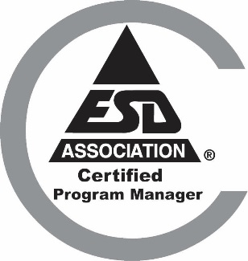
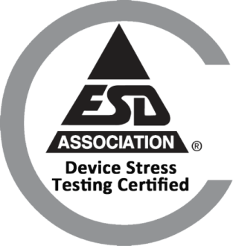
EOS/ESD Association, Inc.
Certification
ESD Certified Professional-Program Manager
Intended for individuals who are involved in designing, implementing, managing, and auditing ESD control programs in their facilities.
ESD Certified Professional-Device Design
This program is intended for individuals who are involved in designing, characterizing and implementing improved ESD protection designs.
Device Stress Testing Certification
Intended for individuals who are involved in ESD or Latch-up stress testing. Offered completely online.
www.esda.org/certification/

Slide 11


EOS/ESD Association, Inc.
Certification
ESD for Circuit Design Engineers Certification (ECEC 1)
Provides the circuit design engineer with the knowledge and the skills to implement ESD protection circuits and latch-up mitigation on their integrated circuit (IC) designs using industry-proven best practices.
ESDA Certified Professional instructor
This class teaches the knowledge and skills needed to develop and deliver an effective and rewarding presentation.
ESD Design Engineer Certification (EDEC)
This certification provides courses that give the foundation for ESD Design Engineers. Courses cover integrated circuit ESD, protection designs, testing essentials, troubleshooting, failure analysis and TLP fundamental.
www.esda.org/certification/

Slide 12
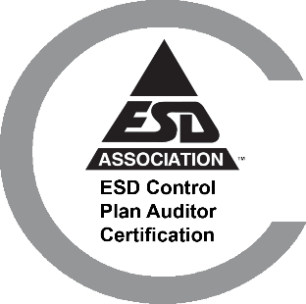

EOS/ESD Association, Inc.
Certification
ESD Control Program Auditor Certification
The certification teaches the knowledge and skills needed to successfully integrate ESD Control Program audits within an organization’s quality management system internal audit program. Resources, such as; checklists, training slides, and guidance documents will be made available to attendees.
ESD Program Associate Certification
This is comprised on three online classes and a knowledge assessment test. It provides the Basics of ESD, necessary fundamental information, the How To’s of measurement and equipment, and a one day S20.20 class meant to provide an introduction to control program basics and auditing.
www.esda.org/certification/

Slide 13


EOS/ESD Association, Inc.
Certification
ESD Compliance Verification Technician to TR53
EOS/ESD Association’s ESD Compliance Verification Technician certification provides an understanding of ESD TR53-01-22, including but not limited to associated equipment, verification, test methods, and troubleshooting that may be used within an organization’s ESD control program.
ESD Facility Certification
To meet the global need in the electronics industry for technically sound ESD Control Programs, EOS/ESD Association, Inc. has established an independent third-party certification program. The program is administered by EOS/ESD Association, Inc. through country-accredited ISO9000 certified bodies that have met the requirements of this program. The Facility Certification Program evaluates a facility's ESD program based on the industry standards ANSI/ESD S20.20 or IEC 61340-5-1.
www.esda.org/certification/

Slide 14
EOS/ESD Association, Inc. Standards
Choose one of ESDA’s Standards Packages to meet all of your document needs!
Hardcopy Standard Subscription Package - Provides hard copies of current documents, with the exception of the ESD TR20.20-ESD Handbook, compiled in a special binder.
Enterprise-Wide Standards License - Provides unlimited users, in all of your company’s facilities worldwide, with copies of ESDA standards documents in PDF format for placement on an internal network.
Per User Electronic Standards Package - Provides one user/site with copies of ESDA standards documents in secure PDF format.
Multi User Electronic Individual Standards - Provides multiple users with a copy of an individual ESDA standards document in secure PDF format.
For details and ordering information please visit:
www.esda.org/standards/

Slide 15
EOS/ESD Association, Inc. Symposium Proceedings
The largest collection of electrostatic research and development papers from around the world.
Symposium Proceedings Enterprise-Wide license - All employees, all locations, company wide. 40 years of symposium proceedings in one set!
Individual Symposium Proceedings - Symposium proceedings available by year from 1979 through Present.
For details and ordering information please visit:
https://www.esda.org/store/training-and-education/?category=4

Slide 16
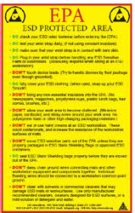
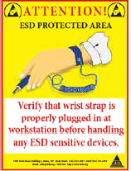
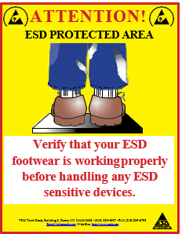

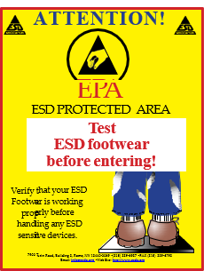
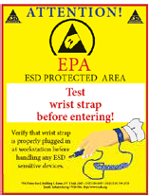
Compliance Posters
Footwear and Wriststrap posters remind employees and visitors of proper ESD control at the workstation.
Three posters for display outside an EPA area to remind employees and visitors to
test their equipment before entering.
Do’s and Don’ts of working in an EPA area.
High quality laminated compliance posters are available for purchase from EOS/ESD Association, Inc! Order online or download a complimentary version at: https://www.esda.org/store/compliance-posters/

Slide 17
Join our team!
Setting the Global Standards for Static Control!
^{EOS/ESD Association, Inc.}
^{218 West Court St.}
^{Rome, NY 13440-2069, USA}
^{PH +1-315-339-6937}
^{Email: info.eosesda@esda.org}
^{www.esda.org}

