Slide 1
EOS/ESD Association, Inc.
Emerging Professionals Tech Talk
ANSI/ESD S20.20-2021 FACILITY CERTIFICATION & ESD CONTROL PROGRAM AUDITOR
July 26- 1:00 AM Eastern Time (Virtual event)
Join the ESDA’s July 2022 Tech Talk, which covers two newly released certification programs - ANSI/ESD S20.20-2021 Facility Certification & ESD Control Program Auditor – hosted by Matt Jane of Tesla. 1. The ANSI/ESD S20.20-2021 Facility Certification provides your organization with a third-party stamp of approval showing that your ESD control program complies with industry standard requirements. Learn what is required to complete the facility certification process and how it may benefit your organization. 2. The ESD Control Program Auditor Certification provides an understanding of the ANSI/ESD S20.20-2021 standard and how its requirements provide a framework to control the risks of electrostatic discharge (ESD) within an organization. With these skills, you can then effectively audit an ESD control program – great for internal auditors, quality professionals, and supply chain professionals.
Register: https://www.esda.org/events/

Slide 2
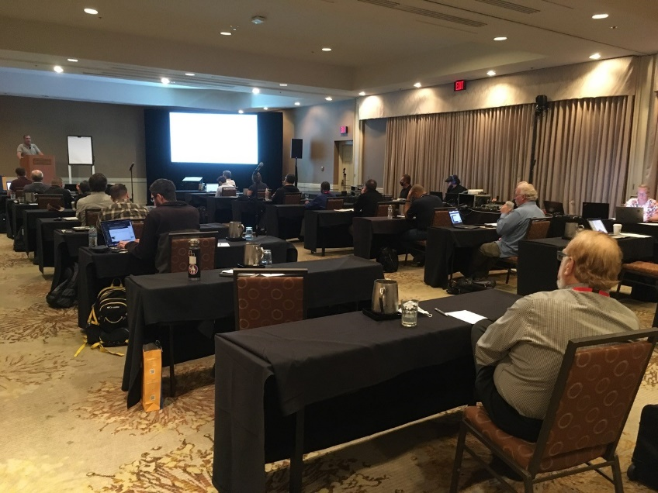
EOS/ESD Association, Inc.
44TH ANNUAL EOS/ESD SYMPOSIUM AND EXHIBITS
September 18-23, 2022 Peppermill Resort & Casino, Reno, NV USA
The EOS/ESD Symposium is dedicated to the understanding of issues related to electrostatic discharge and electrical
transients/overstress, and the application of this knowledge to the solution of problems in consumer, industrial, and
automotive applications, including electronic components, as well as in systems, subsystems, and equipment.
Travel Uncertain – Don't Worry – Submit Anyway!
EOS/ESD Association, Inc is leading conferences with a pioneering approach to our virtual reality. Our hybrid conference
includes both virtual and in person presentations and attendance to suit your needs. Authors who anticipate inability to travel
to a conference because of a travel restriction are encouraged to submit papers
https://www.esda.org/events/44th-annual-eosesd-symposium-and-exhibits

Slide 3
EOS/ESD Association, Inc.
5TH ANNUAL EOS/ESD MANUFACTURING TRACK
September 18-23, 2022 Peppermill Resort & Casino, Reno, NV USA
The EOS/ESD Manufacturing Track offers a full program of activities dedicated to EOS/ESD in manufacturing – control materials, technologies, and techniques. This manufacturing conference focuses on a combination of full and short technical papers, poster presentations, invited papers, discussion groups, workshops, hands-on demonstration sessions, short tutorials, and practical demonstrations of equipment by exhibitors. Travel Uncertain – Don't Worry – Submit Anyway! EOS/ESD Association, Inc is leading conferences with a pioneering approach to our virtual reality. Our hybrid conference includes both virtual and in person presentations and attendance to suit your needs. Authors who anticipate inability to travel to a conference because of a travel restriction are encouraged to submit papers.
https://www.esda.org/events/44th-annual-eosesd-symposium-and-exhibits

Slide 4
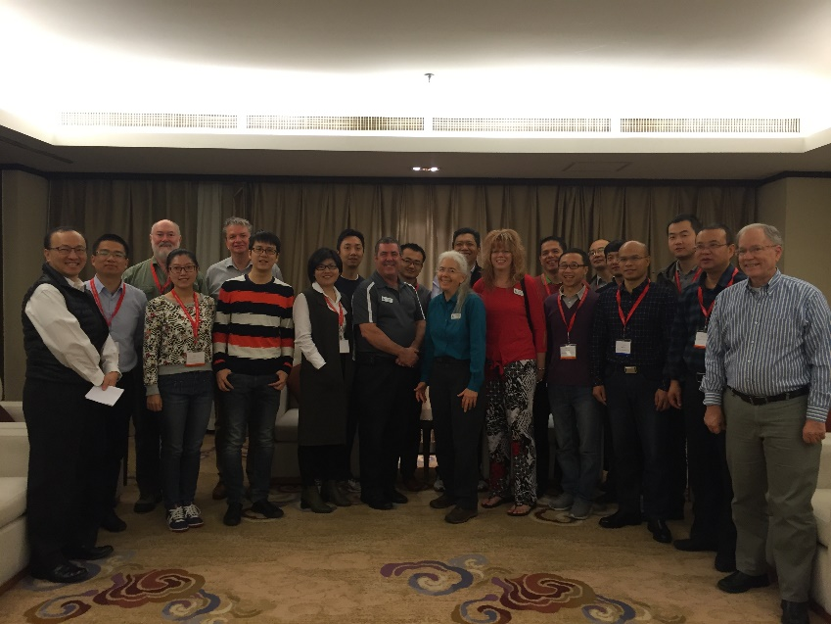
EOS/ESD Association, Inc.
2nd International EOS/ESD Symposium on Design and System (IEDS)
November 9-11, 2022 Virtual Event
EOS/ESD Association, Inc. is sponsoring the 2nd International
EOS/ESD Symposium on Design and System (IEDS). IEDS
2022 is dedicated to the fundamental understanding of issues
related to electrostatic discharge on design and system and
the application of this knowledge to the solution of problems.
The Technical Program Committee solicits symposium
contributions, including data and analysis that advance the
state-of-the-art knowledge, enhance or review the general
knowledge, or discuss new topics related to on-chip ESD
design, system ESD design, and EOS/ESD issues in
manufacturing.
https://www.esda.org/events/2nd-international-eosesd-symposium-on-design-and-system-ieds

Slide 5
EOS/ESD Association, Inc.
2nd Annual india ESD Forum
November 14-15 (Virtual event)
Sponsorship opportunity!
Be a part of the 2nd annual India ESD forum! Our India forum is return­ing for another year bringing forth the realities of ESD requirements in light of the rapidly advancing semiconductor technologies.
Sponsorship deadline: October 7th, 2022
Sponsorship Benefits
Marketing/Advertising benefits
Sponsoring the Anchor event serving Indian semiconductor industries and academia’s need in the area of ESD/LU protection
Event advertisement flyer
Online announcement Page (ESDA website, LinkedIn etc.)
And much more!
https://www.esda.org/events/2nd-annual-india-esd-forum

Slide 6
EOS/ESD Association, Inc.
ESDA Online Academy
Over 40 Online Courses Available for On-Demand Viewing.
Certification Courses
Bundle Purchase Options Available
For a complete list of courses and registration information please visit:
https://www.esda.org/store/training-and-education/?category=3

Slide 7
EOS/ESD Association, Inc.
Certification
ESD Certified Professional-Program Manager
Intended for individuals who are involved in designing, implementing, managing, and auditing ESD control programs in their facilities.
ESD Certified Professional-Device Design
This program is intended for individuals who are involved in designing, characterizing and implementing improved ESD protection designs.
Device Stress Testing Certification
Intended for individuals who are involved in ESD or Latch-up stress testing. Offered completely online.
www.esda.org/certification/

Slide 8
EOS/ESD Association, Inc.
Certification
ESD for Circuit Design Engineers Certification (ECEC 1)
Provides the circuit design engineer with the knowledge and the skills to implement ESD protection circuits and latch-up mitigation on their integrated circuit (IC) designs using industry-proven best practices.
ESDA Certified Professional instructor
This class teaches the knowledge and skills needed to develop and deliver an effective and rewarding presentation.
ESD Design Engineer Certification (EDEC)
This certification provides courses that give the foundation for ESD Design Engineers. Courses cover integrated circuit ESD, protection designs, testing essentials, troubleshooting, failure analysis and TLP fundamental.
www.esda.org/certification/

Slide 9
EOS/ESD Association, Inc.
Certification
ESD Control Program Auditor Certification
The certification teaches the knowledge and skills needed to successfully integrate ESD Control Program audits within an organization’s quality management system internal audit program. Resources, such as; checklists, training slides, and guidance documents will be made available to attendees.
ESD Program Associate Certification
This is comprised on three online classes and a knowledge assessment test. It provides the Basics of ESD, necessary fundamental information, the How To’s of measurement and equipment, and a one day S20.20 class meant to provide an introduction to control program basics and auditing.
www.esda.org/certification/

Slide 10
EOS/ESD Association, Inc.
Certification
ESD Facility Certification
To meet the global need in the electronics industry for technically sound ESD Control Programs, EOS/ESD Association, Inc. has established an independent third-party certification program. The program is administered by EOS/ESD Association, Inc. through country-accredited ISO9000 certified bodies that have met the requirements of this program. The Facility Certification Program evaluates a facility's ESD program based on the industry standards ANSI/ESD S20.20 or IEC 61340-5-1.
www.esda.org/certification/

Slide 11
EOS/ESD Association, Inc. Standards
Choose one of ESDA’s Standards Packages to meet all of your document needs!
Hardcopy Standard Subscription Package - Provides hard copies of current documents, with the exception of the ESD TR20.20-ESD Handbook, compiled in a special binder.
Enterprise-Wide Standards License - Provides unlimited users, in all of your company’s facilities worldwide, with copies of ESDA standards documents in PDF format for placement on an internal network.
Per User Electronic Standards Package - Provides one user/site with copies of ESDA standards documents in secure PDF format.
Multi User Electronic Individual Standards - Provides multiple users with a copy of an individual ESDA standards document in secure PDF format.
For details and ordering information please visit:
www.esda.org/standards/

Slide 12
EOS/ESD Association, Inc. Symposium Proceedings
The largest collection of electrostatic research and development papers from around the world.
Symposium Proceedings Enterprise-Wide license - All employees, all locations, company wide. 40 years of symposium proceedings in one set!
Individual Symposium Proceedings - Symposium proceedings available by year from 1979 through Present.
For details and ordering information please visit:
https://www.esda.org/store/training-and-education/?category=4

Slide 13
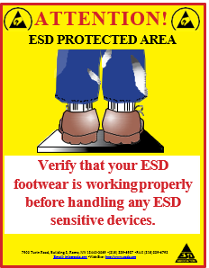
Compliance Posters
Footwear and Wriststrap posters remind employees and visitors of proper ESD control at the workstation.
Three posters for display outside an EPA area to remind employees and visitors to
test their equipment before entering.
Do’s and Don’ts of working in an EPA area.
High quality laminated compliance posters are available for purchase from EOS/ESD Association, Inc! Order online or download a complimentary version at: https://www.esda.org/store/compliance-posters/

Slide 14
Join our team!
Setting the Global Standards for Static Control!
^{EOS/ESD Association, Inc.} ^{218 West Court St.} ^{Rome, NY 13440-2069, USA}
^{PH +1-315-339-6937} ^{Email: info@esda.org} ^{www.esda.org}

