Slide 1
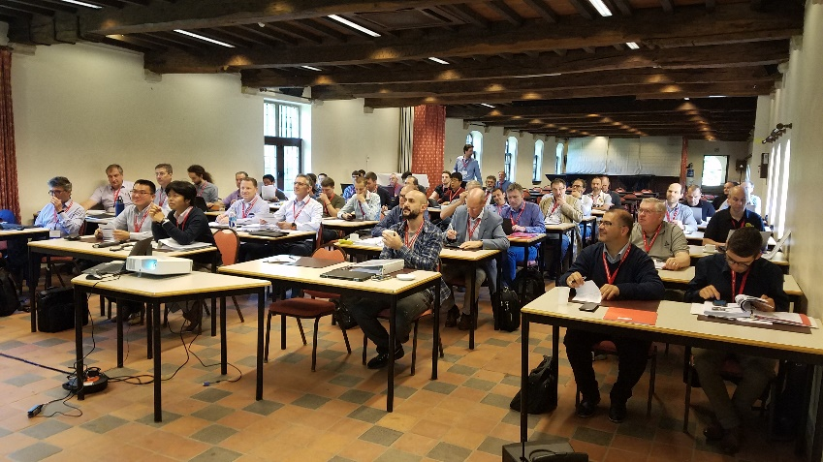
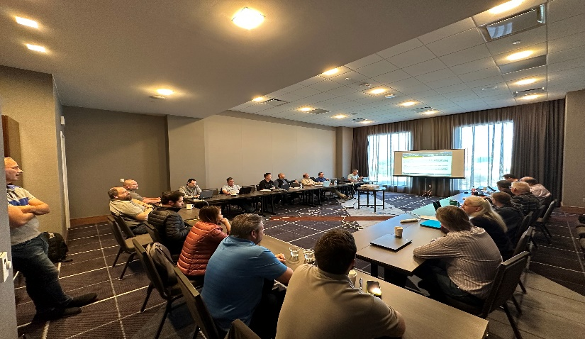
EOS/ESD Association, Inc.
EOS/ESD ASSOCIATION, MEETING SERIES
June 3-10, 2024 Embassy Suites by Hilton Denton Convention Center
Denton, TX
Mark your calendars for an invaluable networking opportunity at the 2024 March Standards Meeting Series, happening March 11-16 at the Embassy Suites in Denton, Texas. Engage with ESD standards working groups, discuss industry hot topics, and explore new research and training opportunities. Enhance your professional growth by connecting with industry peers and staying abreast of the latest in ESD and EOS
https://www.esda.org/events

Slide 2
EOS/ESD Association, Inc.
ESD Compliance Verification Technician to TR53
June 11-13, 2024
Embassy Suites by Hilton Denton Convention Center
Denton, TX
EOS/ESD Association, Inc. established ESD Compliance Verification Technician, which is based on the ESDA’s technical report, ESD-TR53 Compliance Verification of ESD Protective Equipment and Materials.
Become certified by industry leaders, developers, and authors of ESD-TR53.
The ESD Compliance Verification Technician certification provides an understanding of ESD concepts, how compliance verification fits into an ESD control program, and details all the necessary equipment, methods, and best practices to successfully conduct compliance verification within your organization.
Register: https://www.esda.org/events/

Slide 3
EOS/ESD Association, Inc.
2024 ASIA ESD Workshop (ASIA-IEW) Co-located with IPFA
July 15-18, 2024 Marina Bay Sands Expo and Convention Centre
Singapore
In July, 2024, we will embrace a brand new IEW-Asia event co-located with the International Physical and Failure Analysis of Integrated Circuits (IPFA2024).
The workshop will retain the peculiar elements: a tutorial, invited seminar speakers, discussion groups, invited talk speakers, technical presentation sessions, and special interest groups. In addition to everything IEW-Asia provides, IEW-Asia registrants will also be able to attend the full IPFA technical program (any technical session, invited talks, and keynote speakers), including the joint evening poster reception showcasing works from both conferences.
IPFA registrants will have access to IEW keynote and invited talks (but not the other unique elements of IEW-Asia). Therefore, submissions to IEW-Asia will receive exposure to a much broader audience. The IEW is the perfect opportunity to submit late-breaking and exciting new research to stimulate discussion and interaction around new ideas, encouraging new research topics.
https://www.esda.org/events

Slide 4
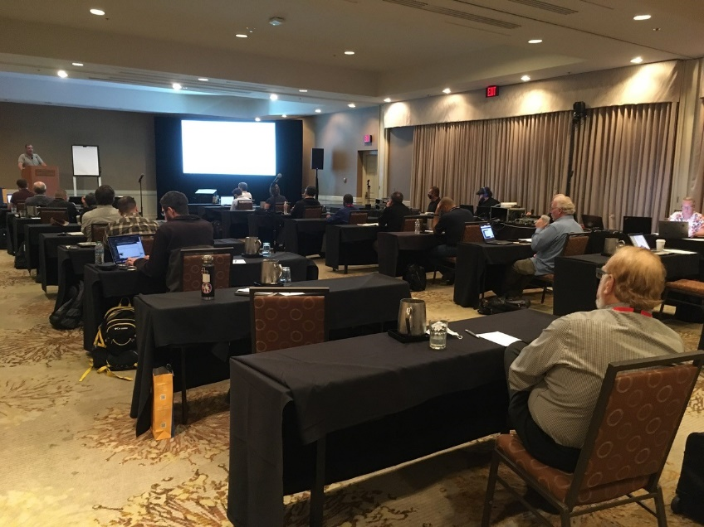
EOS/ESD Association, Inc.
46TH ANNUAL EOS/ESD SYMPOSIUM AND EXHIBITS
September 14-19, 2024 at the Peppermill, Reno, NV USA
The EOS/ESD Symposium is dedicated to the understanding of issues related to electrostatic discharge and electrical transients/overstress, and the application of this knowledge to the solution of problems in consumer, industrial, and automotive applications, including electronic components, as well as in systems, subsystems, and equipment.
https://www.esda.events

Slide 5
EOS/ESD Association, Inc.
ESD Compliance Verification Technician to TR53
October 16-18, 2024
Canmax Technologies, Co., Ltd., 99 Shuangma Street,
Suzhou Industrial Park, 215121, P.R. China
EOS/ESD Association, Inc. established ESD Compliance Verification Technician, which is based on the ESDA’s technical report, ESD-TR53 Compliance Verification of ESD Protective Equipment and Materials.
Become certified by industry leaders, developers, and authors of ESD-TR53.
The ESD Compliance Verification Technician certification provides an understanding of ESD concepts, how compliance verification fits into an ESD control program, and details all the necessary equipment, methods, and best practices to successfully conduct compliance verification within your organization.
Register: https://www.esda.org/events/

Slide 6
EOS/ESD Association, Inc.
ESDA Online Academy
Over 40 Online Courses Available for On-Demand Viewing.
Certification Courses
Bundle Purchase Options Available
For a complete list of courses and registration information please visit:
https://www.esda.org/store/training-and-education/?category=3

Slide 7
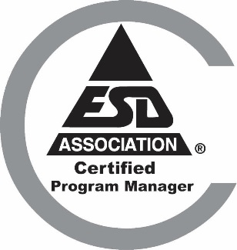
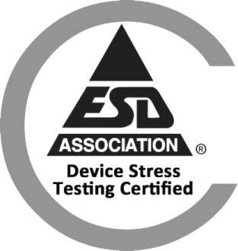
EOS/ESD Association, Inc.
Certification
ESD Certified Professional-Program Manager
Intended for individuals who are involved in designing, implementing, managing, and auditing ESD control programs in their facilities.
ESD Certified Professional-Device Design
This program is intended for individuals who are involved in designing, characterizing and implementing improved ESD protection designs.
Device Stress Testing Certification
Intended for individuals who are involved in ESD or Latch-up stress testing. Offered completely online.
www.esda.org/certification/

Slide 8
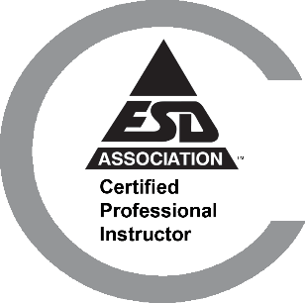
EOS/ESD Association, Inc.
Certification
ESD for Circuit Design Engineers Certification (ECEC 1)
Provides the circuit design engineer with the knowledge and the skills to implement ESD protection circuits and latch-up mitigation on their integrated circuit (IC) designs using industry-proven best practices.
ESDA Certified Professional instructor
This class teaches the knowledge and skills needed to develop and deliver an effective and rewarding presentation.
ESD Design Engineer Certification (EDEC)
This certification provides courses that give the foundation for ESD Design Engineers. Courses cover integrated circuit ESD, protection designs, testing essentials, troubleshooting, failure analysis and TLP fundamental.
www.esda.org/certification/

Slide 9
EOS/ESD Association, Inc.
Certification
ESD Control Program Auditor Certification
The certification teaches the knowledge and skills needed to successfully integrate ESD Control Program audits within an organization’s quality management system internal audit program. Resources, such as; checklists, training slides, and guidance documents will be made available to attendees.
ESD Program Associate Certification
This is comprised on three online classes and a knowledge assessment test. It provides the Basics of ESD, necessary fundamental information, the How To’s of measurement and equipment, and a one day S20.20 class meant to provide an introduction to control program basics and auditing.
www.esda.org/certification/

Slide 10
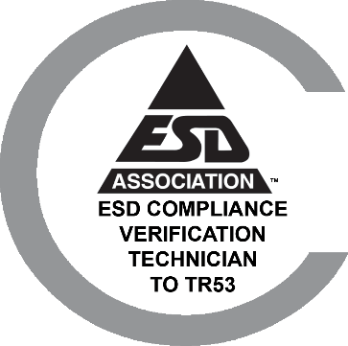
EOS/ESD Association, Inc.
Certification
ESD Compliance Verification Technician to TR53
EOS/ESD Association’s ESD Compliance Verification Technician certification provides an understanding of ESD TR53-01-22, including but not limited to associated equipment, verification, test methods, and troubleshooting that may be used within an organization’s ESD control program.
ESD Facility Certification
To meet the global need in the electronics industry for technically sound ESD Control Programs, EOS/ESD Association, Inc. has established an independent third-party certification program. The program is administered by EOS/ESD Association, Inc. through country-accredited ISO9000 certified bodies that have met the requirements of this program. The Facility Certification Program evaluates a facility's ESD program based on the industry standards ANSI/ESD S20.20 or IEC 61340-5-1.
www.esda.org/certification/

Slide 11
EOS/ESD Association, Inc. Standards
Choose one of ESDA’s Standards Packages to meet all of your document needs!
Hardcopy Standard Subscription Package - Provides hard copies of current documents, with the exception of the ESD TR20.20-ESD Handbook, compiled in a special binder.
Enterprise-Wide Standards License - Provides unlimited users, in all of your company’s facilities worldwide, with copies of ESDA standards documents in PDF format for placement on an internal network.
Per User Electronic Standards Package - Provides one user/site with copies of ESDA standards documents in secure PDF format.
Multi User Electronic Individual Standards - Provides multiple users with a copy of an individual ESDA standards document in secure PDF format.
For details and ordering information please visit:
www.esda.org/standards/

Slide 12
EOS/ESD Association, Inc. Symposium Proceedings
The largest collection of electrostatic research and development papers from around the world.
Symposium Proceedings Enterprise-Wide license - All employees, all locations, company wide. 40 years of symposium proceedings in one set!
Individual Symposium Proceedings - Symposium proceedings available by year from 1979 through Present.
For details and ordering information please visit:
https://www.esda.org/store/training-and-education/?category=4

Slide 13
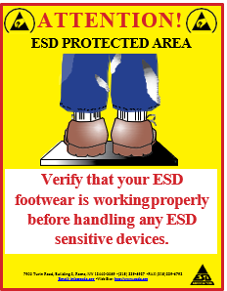
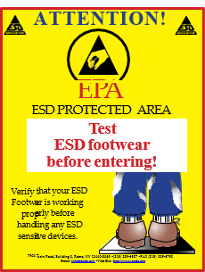
Compliance Posters
Footwear and Wriststrap posters remind employees and visitors of proper ESD control at the workstation.
Three posters for display outside an EPA area to remind employees and visitors to
test their equipment before entering.
Do’s and Don’ts of working in an EPA area.
High quality laminated compliance posters are available for purchase from EOS/ESD Association, Inc! Order online or download a complimentary version at: https://www.esda.org/store/compliance-posters/

Slide 14
Join our team!
Setting the Global Standards for Static Control!
^{EOS/ESD Association, Inc.} ^{218 West Court St.} ^{Rome, NY 13440-2069, USA}
^{PH +1-315-339-6937} ^{Email: info@esda.org} ^{www.esda.org}

