Slide 1
EOS/ESD Association, Inc.
Tutorials
May 7th-9th, 2019
May 7 (½ Day) ESD Myths that Impact ESD Auditing (½ Day) FC101: How To's of In-Plant ESD Auditing and Evaluation Measurements
May 8 (½ Day) Cont’d FC101: How To's of In-Plant ESD Auditing and Evaluation Measurements (½ Day) Hands-on ESD Measurements & Auditing Pitfalls
May 9 FC170: ESD Training for Internal Auditors and Supplier Quality Engineers
Teradyne Conference Center 600 Riverpark Drive North Reading, MA 01864
Register at www.esda.org/events

Slide 2
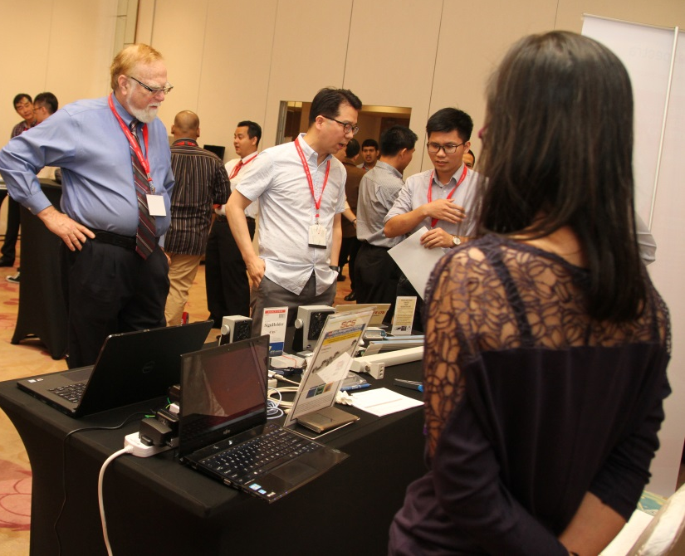
EOS/ESD Association, Inc.
EOS/ESD Manufacturing Symposium in China
May 21-24, 2019 Shanghai, China
Attend the EOS/ESD Manufacturing Symposium in China featuring:
ESD Manufacturing and Design technology
Latest research on EOS and ESD in the rapidly changing world of electronics
May 21-22 Symposium May 23-24 ESD Program Development and Assessment May 23 Tutorial ESD Basics May 24 Tutorials How To’s May 25 (OPTIONAL) PrM Exam
Register at www.esda.org/events/manufacturingsymposium/

Slide 3
EOS/ESD Association, Inc.
Tutorials
June 18-19, 2019
June 18 FC100: ESD Basics for the Program Manager June 19 FC101: How To's of In-Plant ESD Auditing and Evaluation Measurements DoubleeTree by Hilton O’Hare-Rosemont 5460 North River Road Rosemont, IL 60018
Register at www.esda.org/events

Slide 4
EOS/ESD Association, Inc.
ESDA Standards Committee Meeting
September 9-16, 2019
Meeting Series Education, Symposium & Standards Meetings
Riverside Convention Center, Riverside, CA, USA The Mission Inn Hotel & Spa, Riverside, CA Marriot Riverside at the Convention Center, Riverside, CA
For meeting schedules visit: https://esda.org/committees/standards-working-groups/

Slide 5
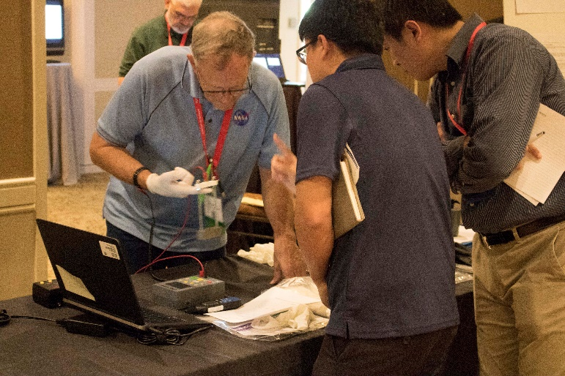
EOS/ESD Association, Inc.
41st Annual Symposium/Meeting Series
September 9-20, 2019 Riverside Convention Center, Riverside, CA,
RETURN of the MANUFACTURING TRACK: EOS/ESD in Manufacturing –
• Featured keynote presentation provides the latest discoveries in EOS/ESD control.
• Workshops allow you to discuss your companies unique challenges with industry professionals and peers.
• Networking opportunities to get answers from industry experts on important technical questions.
• Tutorials and seminars for valuable training to keep you at the top of your field.
www.esda.org/events/symposia/

Slide 6
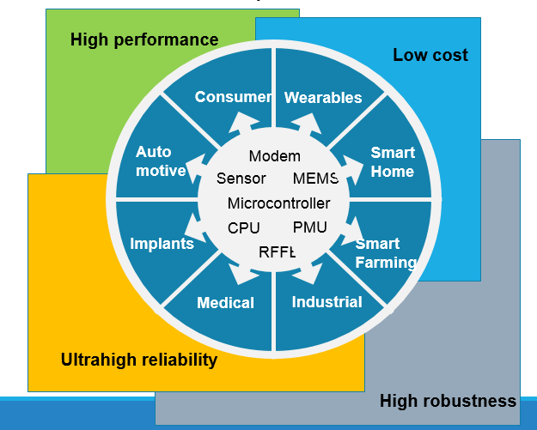
EOS/ESD Association, Inc.
Workshop on Robustness of IoT Devices
Scheduled as co-located event at EOSESD Symposium 2019, Riverside, Sep18-19
Invited talks
Discussion groups
Networking events
EOS/ESD Symposium September 9-20, 2019
Examples of IoT applications and their robustness requirements
Insight into ESD, electrical robustness and safety aspects
Discussion group and ecosystem meetings to discuss electrical robustness of IoT systems related to hardware design and testing
www.esda.org/events/symposia/

Slide 7
EOS/ESD Association, Inc.
EOS/ESD Manufacturing Symposium in Malaysia
October 14-18, 2019 Penang, Malaysia
Attend the EOS/ESD Manufacturing Symposium in Penang featuring:
ESD Manufacturing and Design technology
Latest research on EOS and ESD in the rapidly changing world of electronics
October 14 Tutorials ESD Basics October 15 Tutorials How To’s October 16 Tutorials/Symposium S20.20 Day 1 October 17 Tutorials/Symposium S20.20 Day 2 October 18 (OPTIONAL) PrM Exam
Register at www.esda.org/events/manufacturingsymposium/

Slide 8
EOS/ESD Association, Inc.
Workshop Forum
^{October 21-22, 2019}
^{3rd Annual ESD Forum Workshop}
The workshop will address:
IC Design: Design challenges for IC ESD Protection
IC Testing: ESDA/JEDEC/ANSI JS-001 and JS-002, The content and their correct implementation
System Design: System Level ESD Design; Multiple design challenges
System Testing: Implementation of the IEC61000-4-2 test
System Design: The base for SEED and TVS diode characteriziation and modeling
Canmax, 99 Shuangma Street, Suzhou Industrial Park, Jiangsu, Suzhou, China
Register at www.esda.org/events

Slide 9
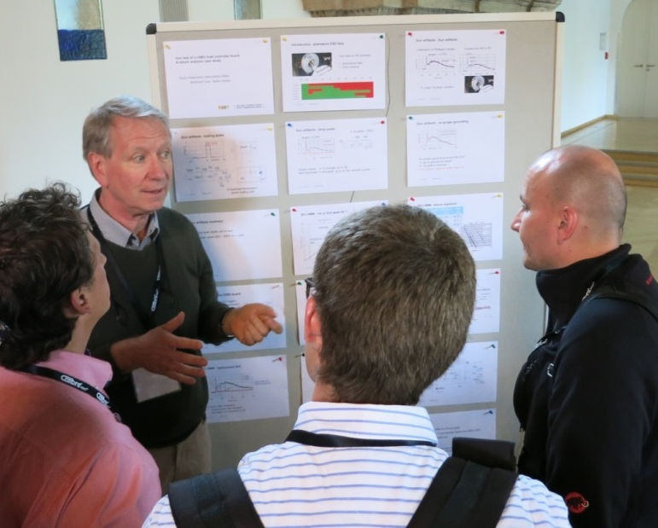
EOS/ESD Association, Inc.
International Electrostatic Discharge Workshop IEW
May 4-8, 2020 Tagungshotel Jesteburg, Hamburg, Germany
IEW facilitates access to and interactions with industry leaders through invited seminars, technical sessions, discussion groups (DGs), and invited speakers.
• Listen to viewpoints of industry experts
• Share your ideas and opinions on EOS/ESD topics
• Explore industry best practices and give your inputs
• Interact/network with EOS/ESD industry experts
www.esda.org/events/IEW/

Slide 10
EOS/ESD Association, Inc.
ESDA Online Academy
Over 40 Online Courses Available for On-Demand Viewing.
Certification Courses
Bundle Purchase Options Available
For a complete list of courses and registration information please visit:
www.esda.org/training-and-education/online-training

Slide 11
EOS/ESD Association, Inc.
Certification
ESD Certified Professional-Program Manager
Intended for individuals who are involved in designing, implementing, managing, and auditing ESD control programs in their facilities.
ESD Certified Professional-Device Design
This program is intended for individuals who are involved in designing, characterizing and implementing improved ESD protection designs.
Device Stress Testing Certification
Intended for individuals who are involved in ESD or Latch-up stress testing. Offered completely online.
TR53 Technician Certification
The TR53 Technician Certification Program is based on the ESDA's technical report, ESD-TR53 Compliance Verification of ESD Protective Equipment and Materials.
www.esda.org/certification/

Slide 12
EOS/ESD Association, Inc. Standards
Choose one of ESDA’s Standards Packages to meet all of your document needs!
Hardcopy Standard Subscription Package - Provides hard copies of current documents, with the exception of the ESD TR20.20-ESD Handbook, compiled in a special binder.
Enterprise-Wide Standards License - Provides unlimited users, in all of your company’s facilities worldwide, with copies of ESDA standards documents in PDF format for placement on an internal network.
Per User Electronic Standards Package - Provides one user/site with copies of ESDA standards documents in secure PDF format.
Multi User Electronic Individual Standards - Provides multiple users with a copy of an individual ESDA standards document in secure PDF format.
For details and ordering information please visit:
www.esda.org/standards/

Slide 13
EOS/ESD Association, Inc. Symposium Proceedings
The largest collection of electrostatic research and development papers from around the world.
Symposium Proceedings Enterprise-Wide license - All employees, all locations, company wide. 40 years of symposium proceedings in one set!
Individual Symposium Proceedings - Symposium proceedings available by year from 1979 through Present.
For details and ordering information please visit:
www.esda.org/events/proceedings/

Slide 14
Corporate Bundle Packages
Bundle all of your EOS/ESD Association, Inc. needs into one package for easy budgeting!
Level 1 $10,000 (25 Credits)-$400/credit
Level 2 $5,000 (12 Credits)-$417/credit
Level 3 $2,500 (6 Credits)-$417/credit

Slide 15
Corporate bundle package components
Credits can be used for:
Enterprise-Wide Standards License = 10 bundle credits
Per User Standards License = 4 bundle credits
One Standards Subscription with Handbook = 3 bundle credits
Three Online Academy credits = 1 bundle credit
One Symposium Registration = 1 bundle credit
One IEW Registration = 4 bundle credits
One Two-Day Seminar Registration = 3 bundle credits
One Day Tutorial Registration = 1 bundle credit
For additional options, custom bundles, or PO acceptance contact:
EOS/ESD Association, Inc. at +1-315-339-6937 or email: info@esda.org

Slide 16
Example of Corporate Bundle Application
Corporate bundle credits applied to EOS/ESD Association, Inc. Tutorial Programs (example Level 2 & 3)
Full day of Tutorial(s) at $710 = 1 Bundle credit for $417
saving $293 [$ 710 - $ 417]
ANSI/ESD S20.20 Seminar at $1,710 = 3 Bundle credits for $1,251
saving $459 [$ 1,710 - $ 1,251]
Savings potential
up to $3,096
For additional options, custom bundles, or PO acceptance contact:
EOS/ESD Association, Inc. at +1-315-339-6937 or email: info@esda.org

Slide 17
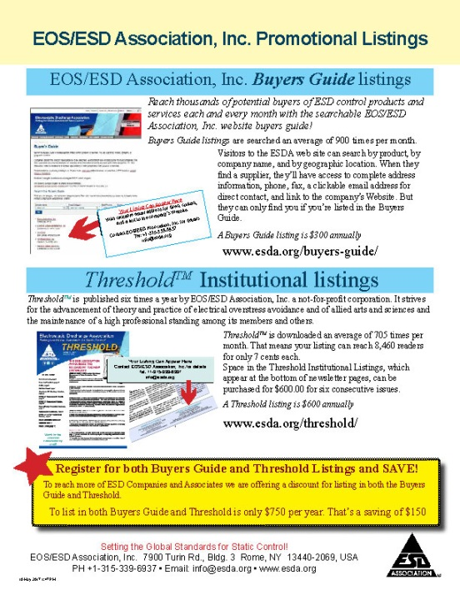
Buyers Guide and Threshold Listings
Reach thousands of potential buyers of ESD control products and services each and every month with the searchable EOS/ESD Association, Inc. website buyers guide! A Buyers Guide listing is $300 annually
ThresholdTM is downloaded an average of 705 times per month. That means your listing can reach 8,460 readers for only 7 cents each. A Threshold listing is $600 annually
Register for both Buyers Guide and Threshold Listings and SAVE!
To list in both Buyers Guide and Threshold is only $750 per year. That’s a saving of $150

Slide 18
Calendar of Events
^{May 7th-9th, 2019}
May 7 (½ Day) ESD Myths that Impact ESD Auditing
(½ Day) FC101: How To's of In-Plant ESD Auditing and Evaluation Measurements
May 8 (½ Day) Cont’d FC101: How To's of In-Plant ESD Auditing and Evaluation Measurements
(½ Day) Hands-on ESD Measurements & Auditing Pitfalls
May 9 FC170: ESD Training for Internal Auditors and Supplier Quality Engineers ^{Teradyne Conference Center}
^{600 Riverpark Drive}
^{North Reading, MA 01864}
^{May 21-24, 2019}
Manufacturing Symposium in China ^{The Hilton Garden Inn}
^{Shanghai China}
^{June 3-14, 2019}
^{Summer Virtual Meeting Series} ^{June 18-19, 2019}
June 18 FC100: ESD Basics for the Program Manager
June 19 FC101: How To's of In-Plant ESD Auditing and Evaluation Measurements DoubleeTree by Hilton Hotel Chicago O’Hare Airport - Rosemont
^{5460 North River Road}
^{Rosemont IL 60018}
^{September 9-20, 2019} ^{EOS/ESD Symposium & Exhibits} EOS/ESD Association Meeting Series - Sept 9-15
EOS/ESD Symposium, Tutorials, and Exhibits - Sept 15-20
Riverside Convention Center, Riverside, CA ^{October 14-18, 2019}
Manufacturing Symposium in Penang
Penang Skills Development Centre
^{Penang, Malaysia}
^{October 21-22, 2019} ^{China ESD Forum} Canmax, 99 Shuangma Street, Suzhou Industrial Park, Jiangsu, Suzhou, China
^{October 24-25, 2019} ^{Tutorials in China} Canmax, 99 Shuangma Street, Suzhou Industrial Park, Jiangsu, Suzhou, China
^{May 4-8, 2020} International ESD Workshop (IEW) ^{Tagungshotel Jesteburg}
^{Hamburg, Germany}

Slide 19
Join our team!
Setting the Global Standards for Static Control!
^{EOS/ESD Association, Inc.} ^{7900 Turin Rd., Bldg. 3} ^{Rome, NY 13440-2069, USA}
^{PH +1-315-339-6937} ^{Email: info@esda.org} ^{www.esda.org}

