Slide 1


Electrostatic Discharge (ESD) control
EOS/ESD association, inc

Slide 2

CONTENT
1
What is ESD?
2
Why we Deal with ESD
3
Static Charge Generation
4
What Causes ESD?
5
Prevent ESD Damage
ESD Control

Slide 3

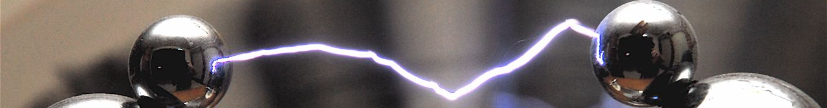
WHAT IS ESD?
A rapid, spontaneous transfer of electrostatic charge induced by a high electrostatic field.
Usually, the charge flows through a spark between two conductive bodies at different electrostatic potentials as they approach one another.
Many people have experienced static electricity and "shocks", or electrostatic discharge when touching a metal doorknob after walking across a carpeted floor or after sliding across a car seat.
ESD Control

Slide 4


WHY WE DEAL WITH ESD
ESD continues to be one of the most serious problems facing the electronics industry today.
ESD affects:
Production yields
Manufacturing costs
Product quality and reliability
The cost of damaged devices ranges from only a few cents for a simple diode
to thousands of dollars for complex integrated circuits.
It is unlikely that any company which ignores static control will be able to manufacture and deliver undamaged electronic parts successfully.
ESD Control

Slide 5
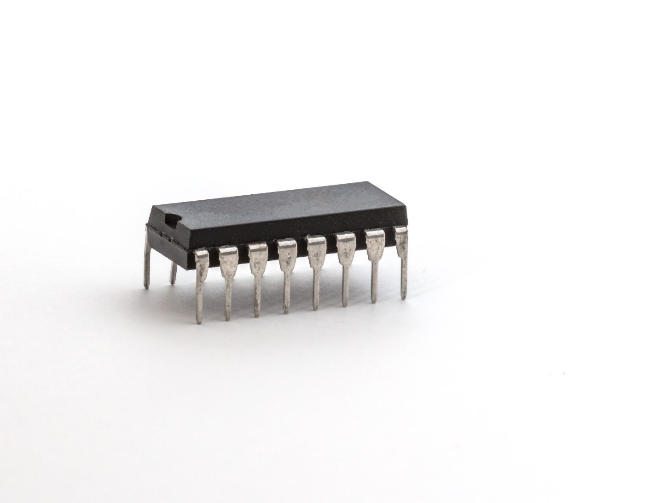

WHY WE DEAL WITH ESD
ESD can change the electrical characteristics of a semiconductor device, degrading or destroying it. ESD may also upset the normal operation of an electronic system, causing equipment malfunction or failure.
When an electronic device is exposed to an ESD event, it may no longer function. The ESD event may have caused a metal melt, junction breakdown, or oxide failure. The device's circuitry is permanently damaged, causing the device to stop functioning totally or at least partially.
A device that is exposed to an ESD event may be partially degraded, yet continue to perform its intended function. Therefore a latent defect is difficult to identify. Still, the operating life of the device may be reduced.
ESD Control
ESD Game Changing Threats

Slide 6
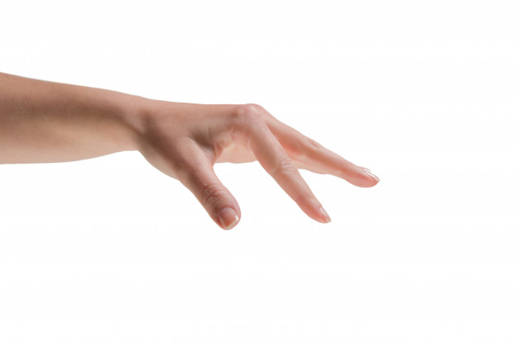
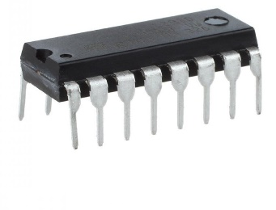
WHY WE DEAL WITH ESD
You can not see, hear or feel ESD unless it has a potential of 2000-3000 Volts!
Sensitive devices could be damaged by ESD with 100V or less!
You experience nothing, but the device is destroyed!
ESD Control
ESD Game Changing Threats

Slide 7


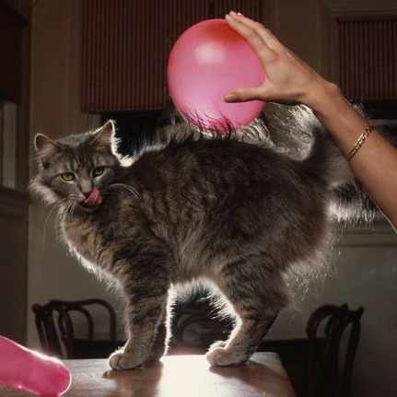
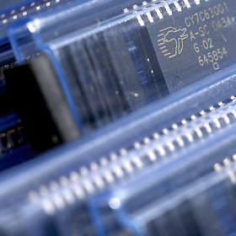
Static Charge Generation
Electrostatic charge is most commonly created by the contact and separation of two materials.
For example, a person walking across the floor generates static electricity as shoe
soles contact and then separate from the floor surface.
Pulling off a piece of tape involves charge generation.
An electronic device sliding into or out of a bag, magazine, or tube generates an electrostatic charge as the device's housing and metal leads make multiple contacts and separations with the surface of the container.
ESD Control

Slide 8
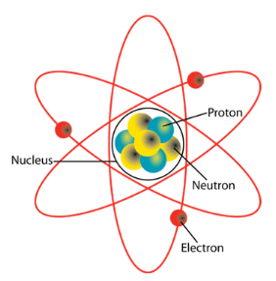
Static Charge Generation
Creating electrostatic charge by contact and separation of materials is known as triboelectric charging. It involves the transfer of electrons between materials.
Which material loses electrons and which gains electrons will depend on the nature of the two materials. The material that loses electrons becomes positively charged, while the material that gains electrons is negatively charged.
ESD Control

Slide 9

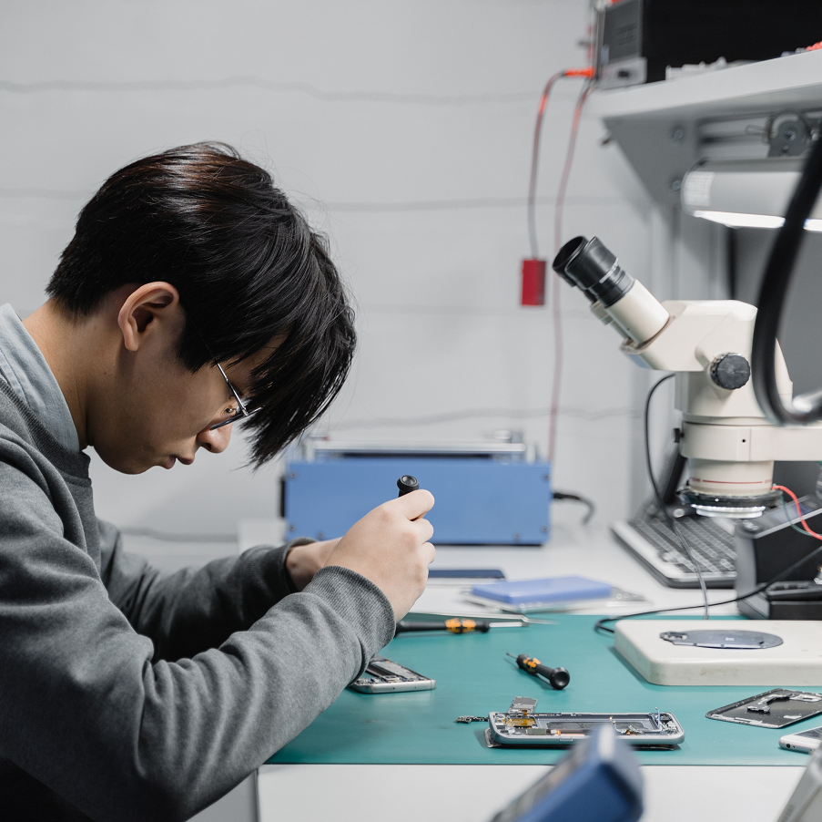
WHAT CAUSES ESD?
When a person walks across a floor, or moves with a chair, an electrostatic charge accumulates on their body.
These movements can result in up to a thousand volts measured on the human body.
Simple contact (or proximity) of a finger to an ESD sensitive device or assembly can allow the body to discharge and possibly cause ESD damage to products.
ESD Control

Slide 10
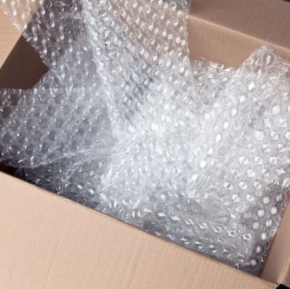
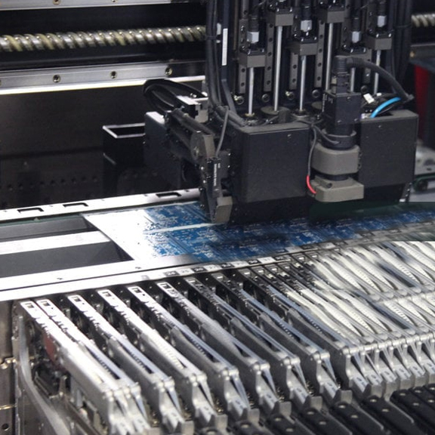
WHAT CAUSES ESD?
Insulative materials (commonly plastics) can generate very strong electrostatic fields.
If we handle ESD sensitive devices in the presence of an electrostatic field, there is a risk for ESD damage.
Ungrounded machine parts could also be charged and pose a risk for ESD sensitive devices.
ESD Control

Slide 11
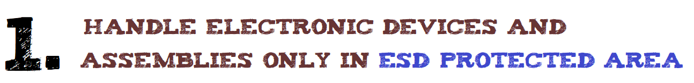
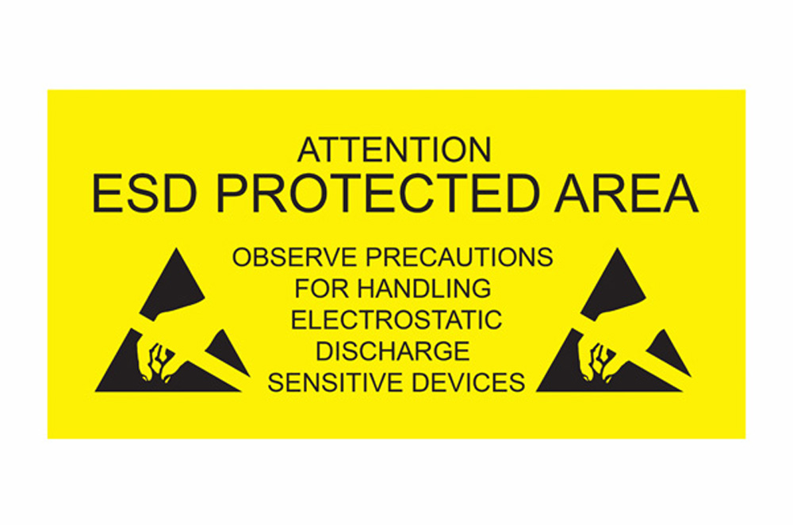
PREVENT ESD DAMAGE
Open the sensitive device’s static shielding packaging only inside the ESD Protected Area (EPA)
Follow the rules of the EPA
  EPAs can be as small as one table or as large as an entire room
ESD Control

Slide 12

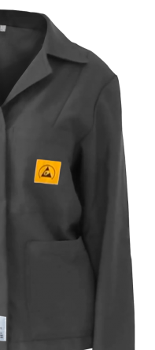
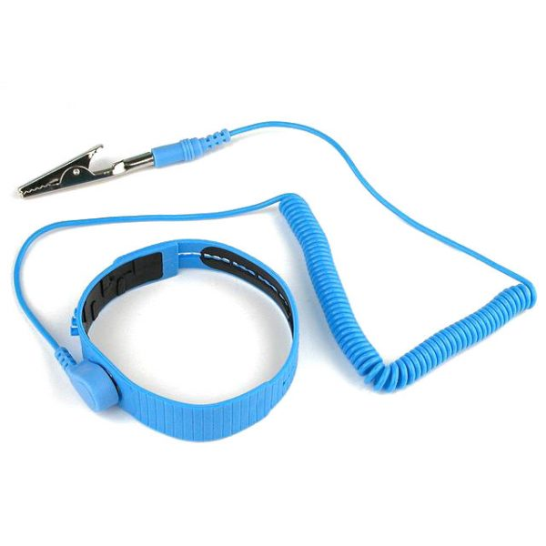
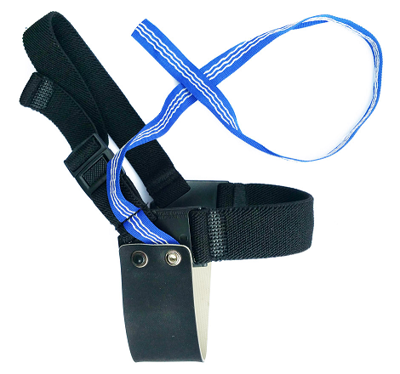

PREVENT ESD DAMAGE
Your process defines the control items you use. Don’t forget those that apply.
Use your wrist strap
Use shoe grounders on both feet
Use your ESD garment properly
Check your wrist strap and footwear regularly

Slide 13

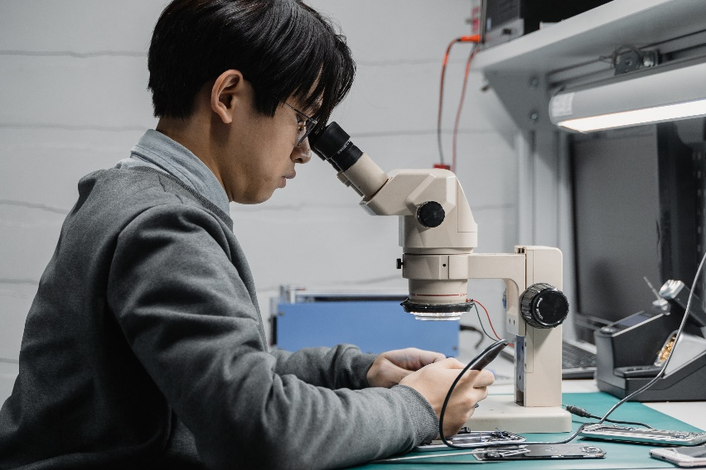
PREVENT ESD DAMAGE
Remove charge generating materials (common plastics)
If an air ionizer is needed for your process, ensure that it is turned on and operating in the right direction
ESD Control

Slide 14

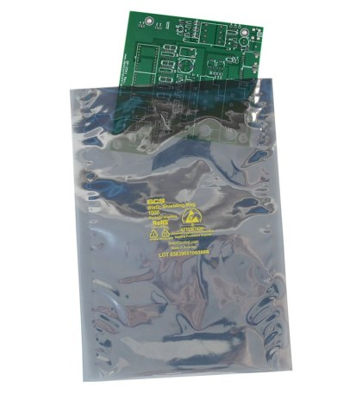
PREVENT ESD DAMAGE
Use only approved containers and packaging materials.
Always close containers completely.
Never open ESD sensitive product packaging unless it is inside an EPA.
ESD Control

Slide 15

PREVENT ESD DAMAGE
Not only devices, but assemblies are ESD sensitive
Don’t allow anyone in the EPA without proper protection
Ground all surfaces and parts which make contact with ESDS items
Always use approved materials and items inside the EPA
ESD Control

Slide 16
For more information...
The EOS/ESD Association, Inc. has documents and additional training available to guide you in ensuring product performance and reliability.
Resources can be found:
https://www.esda.org/
Additional Training Available at:
https://www.esda.org/training-and-education/
ESD Control

Slide 17
End of training
THANK YOU!
ESD Control

